Slide 1
Muhammad Sohail Afzal

Slide 2
Reinforcement Learning
Reinforcement learning uses rewards and punishments as signals for positive and negative behavior.
Goal is to find a suitable action model that would maximize the total cumulative reward of the agent.
Reinforcement learning is not a type of neural network. It is basically a different approach for machine learning.

Slide 3
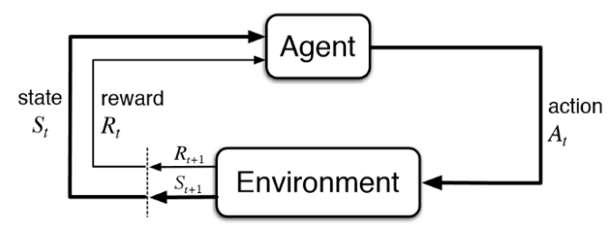
Reinforcement Learning
The figure below illustrates the action-reward feedback loop of a generic RL model.

Slide 4
Reinforcement Learning
There is a significant difference between Reinforcement Learning and Supervised Learning. In supervised learning, the training data has the labels that help the model to train from the right set of labels. Whereas in Reinforcement Learning there is no right label and the agent is the one who decides how to perform the given task. In the absence of training set, the agent is bound to learn from its experience after performing the task for a certain number of times

Slide 5
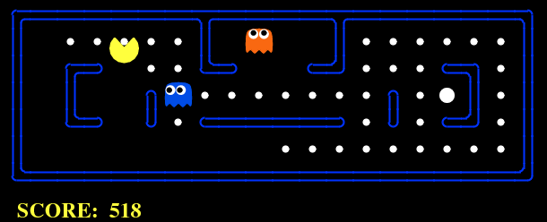
Reinforcement Learning
An RL problem can be best explained through games. Let’s take the game of PacMan where the goal of the agent(PacMan) is to eat the food in the grid while avoiding the ghosts on its way. In this case, the grid world is the interactive environment for the agent where it acts. Agent receives a reward for eating food and punishment if it gets killed by the ghost (loses the game). The states are the location of the agent in the grid world and the total cumulative reward is the agent winning the game.

Slide 6
Reinforcement Learning
EXPLORATION AND EXPLOITATION IN REINFORCEMENT LEARNING
Exploration
Exploration is more of a long-term benefit concept where it allows the agent to improve its knowledge about each action which could lead to long term benefit.
Exploitation
Exploitation basically exploits the agent’s current estimated value and chooses the greedy approach to get the most reward. However, the agent is being greedy with the estimated value and not the actual value, so chances are it might not get the most reward.

Slide 7
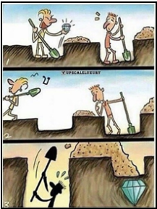
Reinforcement Learning
Let’s take an interesting example to understand Exploration- Exploitation properly.

Slide 8
Reinforcement Learning
Let’s say your friend and you digging in the hope that they will get diamond out of it. Your friend gets lucky and finds the diamond before you and walks off happily.
By seeing this, you get a bit greedy and think that you might also get lucky. So, you start digging at the same spot as your friend.
Your action is called the greedy action and the policy is called the greedy policy.
However, in this situation the Greedy policy would fail because a bigger diamond is buried where you were digging in the beginning.

Slide 9
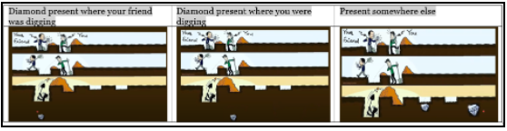
Reinforcement Learning
However, when your friend found the diamond, the only knowledge you got was the depth at which the diamond was buried. You do not have the knowledge of what lies beyond that depth. In reality the diamond may be where you were digging in the beginning or it may be where your friend was digging, or it may be completely at a different place.

Slide 10
Reinforcement Learning
With such partial knowledge about future states and future rewards, our reinforcement learning agent will be in dilemma on whether to exploit the partial knowledge to receive some rewards or it should explore unknown actions which could result in much larger rewards.
However, we cannot choose both explore and exploit simultaneously.

Slide 11
Reinforcement Learning
In order to build an optimal policy, the agent faces the dilemma of exploring new states while maximizing its overall reward at the same time. This is called Exploration vs Exploitation trade-off. To balance both, the best overall strategy may involve short term sacrifices. Therefore, the agent should collect enough information to make the best overall decision in the future.
The exploration-exploitation trade-off is a fundamental dilemma whenever you learn about the world by trying things out. The dilemma is between choosing what you know and getting something close to what you expect ('exploitation') and choosing something you aren't sure about and possibly learning more ('exploration')

Slide 12
Reinforcement Learning
Some key terms that describe the basic elements of an RL problem are:
Environment — Physical world in which the agent operates
State — Current situation of the agent
Reward — Feedback from the environment
Policy — Method to map agent’s state to actions
Value — Future reward that an agent would receive by taking an action in a particular state

Slide 13
Reinforcement Learning
It is being used to automate games like Dotta, Atari games etc. One popular application is chess game of AlphaGo by DeepMind where computer has beaten a top class player (human).
It is also being used in Self driving cars
etc

Slide 14
Reinforcement Learning
Model free vs Model Based :
In reinforcement learning (RL), a model-free algorithm (as opposed to a model-based one) is an algorithm which does not use the transition probability distribution (and the reward function) associated with the Markov decision process (MDP), which, in RL, represents the problem to be solved. The transition probability distribution (or transition model) and the reward function are often collectively called the "model" of the environment (or MDP), hence the name "model-free“.
Think of it this way, if the agent can predict the reward for some action before actually performing it thereby planning what it should do, the algorithm is model-based. While if it actually needs to carry out the action to see what happens and learn from it, it is model-free.

Slide 15
Reinforcement Learning
Widely used models for reinforcement learning
Markov decision process (MDP)
Q - learning

Slide 16
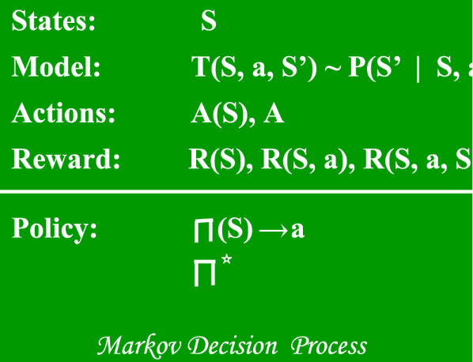
Reinforcement Learning
Markov Decision Process (MDP’s) – are mathematical frameworks for mapping solutions in RL. The set of parameters that include Set of finite states – S, Set of possible Actions in each state – A, Reward – R, Model – T, Policy – π. The outcome of deploying an action to a state doesn’t depend on previous actions or states but on current action and state. This property is also known as markovian property.

Slide 17
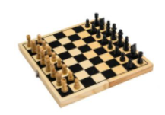
Reinforcement Learning
For example, while playing chess, you are not curious about what happened in the past but about what is the current state of the game. Based on that, you will make decision. This is MDP.

Slide 18
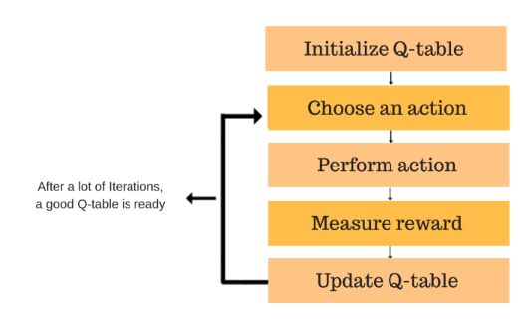
Reinforcement Learning
Q – learning :
It’s a value-based model free approach for supplying information to intimate which action an agent should perform. It revolves around the notion of updating Q values which shows the value of doing action A in state S. Value update rule is the main aspect of the Q-learning algorithm.

Slide 19
Reinforcement Learning
Q – learning :
What’s ‘Q’?
The ‘q’ in q-learning stands for quality. Quality in this case represents how useful a given action is in gaining some future reward.
Create a q-table
When q-learning is performed we create what’s called a q-table or matrix that follows the shape of [state ,action] and we initialize our values to zero. We then update and store our q-values after an episode. This q-table becomes a reference table for our agent to select the best action based on the q-value.

Slide 20
Reinforcement Learning
Q – learning :
Here are the 3 basic steps:
Agent starts in a state (s1) takes an action (a1) and receives a reward (r1)
Agent selects action by referencing Q-table with highest value (max) OR by random (epsilon, ε)
Update q-values

Slide 21

Reinforcement Learning
Q – learning is a commonly used model-free approach which can be used for building a self-playing PacMan agent. It revolves around the notion of updating Q values which denotes value of performing action a in state s. The following value update rule is the core of the Q-learning algorithm.
The main idea of Q-Learning is to “explore” all possibilities of state-action pairs and estimate the long-term reward that will be received by applying an action in a state (the Q(s,a) value). Eventually, Q-Learning converges to the optimal actuation given some restrictions.

Slide 22
Machine learning
Sometimes, Q- learning lacks the generality on unseen data. To overcome this problem, more advanced algorithms are used such as Deep Q-Networks(DQNs) which use Neural Networks to estimate Q-values.

